Slide 1

IPL ANALYSIS USING POWER BI
PRESENTED BY:
G.MOHIT SAI BALAJI (RA2211026010142)
K.GURU CHARAN (RA2211026010141)

Slide 2
INTRODUCTION
This IPL Dashboard provides a comprehensive analysis of team and player performances across multiple IPL seasons. It presents key batting and bowling statistics, including the total runs, number of boundaries and sixes, and strike rates for prominent players like MS Dhoni. The dashboard also highlights bowler statistics such as wickets taken, economy rate, and average. Interactive visualizations allow users to explore win patterns by venue, toss decisions by season, and seasonal victories by teams, with Chennai Super Kings emerging as the title winner for the selected season. This data-driven approach offers valuable insights into the dynamics of IPL matches, enhancing understanding of performance trends and strategic outcomes.

Slide 3
DATASET
Ball-by-Ball Data: Contains detailed information for each delivery in a match. Key columns include:match_id, season, and start_date for identifying and organizing the data by match.batting_team, bowling_team, striker, and non_striker for in-play information.runs_off_bat, extras, and total_runs to record scoring outcomes.Dismissal data such as wicket_type and player_dismissed for player performance insights.
Matches Data: Provides summary information on each match, with columns like:id (match ID), season, city, and venue for match metadata.team1, team2, toss_winner, and winner for game results and toss details.result, dl_applied, win_by_runs, and win_by_wickets for outcome information.player_of_match and umpire names for further context.

Slide 4
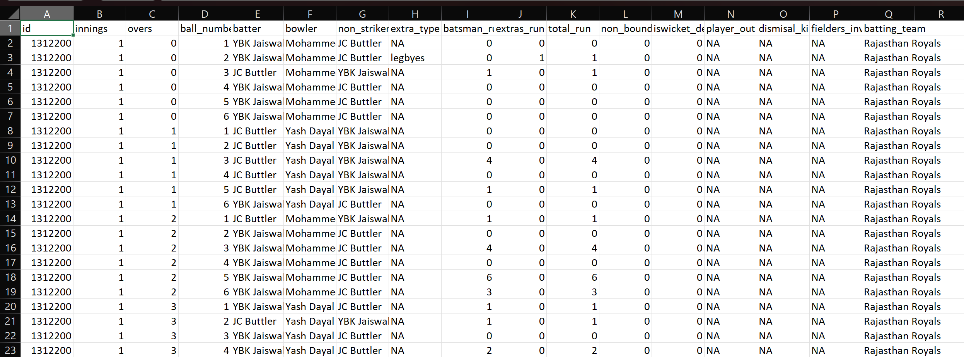
Ball by ball dataset:

Slide 5
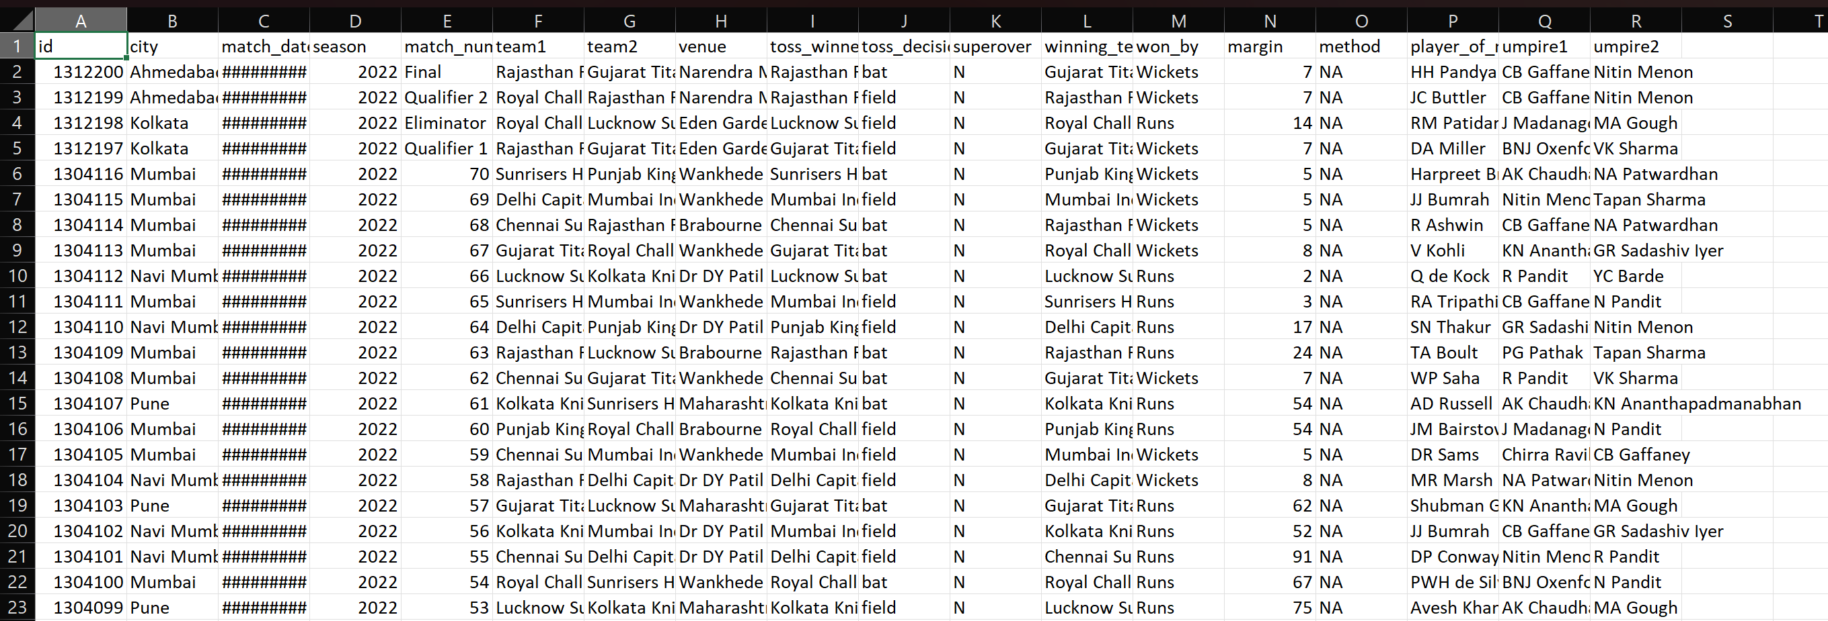
ipl_ball_by_ball_2008_2022 :

Slide 6
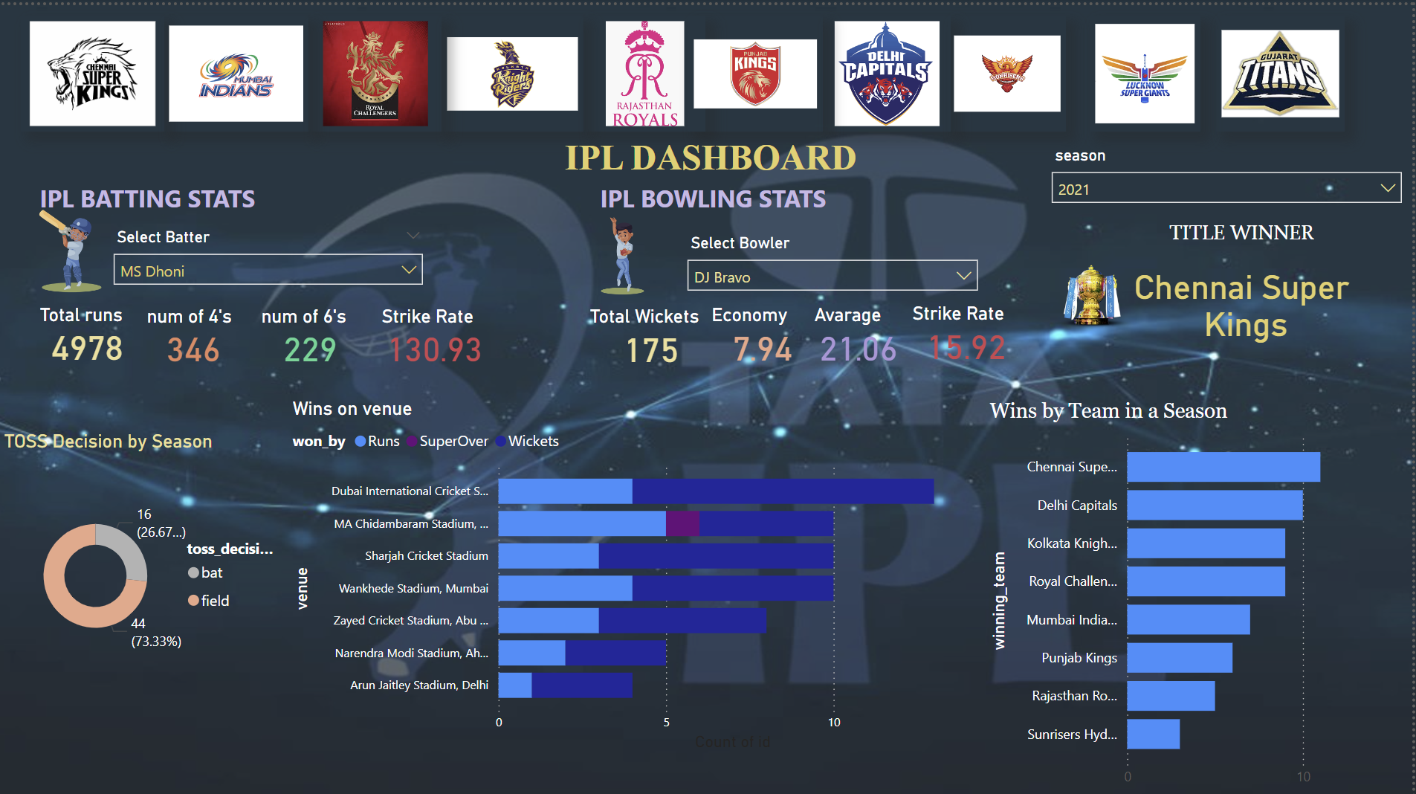
DASHBOARD OVERVIEW :

Slide 7
Team Logos at the Top:
This row of logos at the top represents the different IPL teams. It provides a quick reference for selecting specific teams to analyze or to see their statistics collectively across seasons

Slide 8
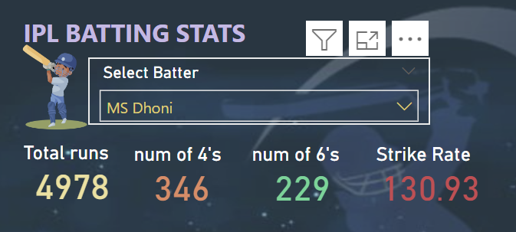
IPL Batting Stats:
This section focuses on individual batting performance metrics. It includes:Total Runs: Displays the total runs scored by a selected player. In this example, MS Dhoni has scored 4,978 runs.Number of 4’s: Shows the count of boundaries (fours) hit by the player.Number of 6’s: Shows the count of sixes hit by the player.Strike Rate: Displays the strike rate, which reflects how aggressive the player’s scoring rate is.Users can select a player from the dropdown menu to view specific batting stats.

Slide 9
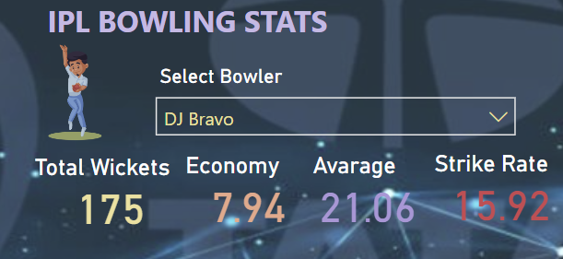
IPL Bowling Stats:
This section provides statistics for bowlers. It includes:Total Wickets: Number of wickets taken by the selected bowler (e.g., DJ Bravo).Economy Rate: Measures the runs conceded per over by the bowler.Average: Shows the bowler’s average, calculated by dividing the total runs conceded by the number of wickets taken.Strike Rate: Reflects how many balls, on average, the bowler takes to get a wicket.Users can choose different bowlers from the dropdown menu to see their performance stats.

Slide 10

Title Winner:
Displays the winning team for the selected season. In the example shown, Chennai Super Kings are the title winners. This adds a season-specific context to the data, giving insights into which team emerged victorious that year.

Slide 11
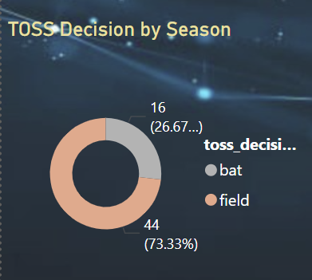
Toss Decision by Season:
This visualization presents the toss decisions made by each team in different seasons.
The following decisions include:
Bat
Ball

Slide 12
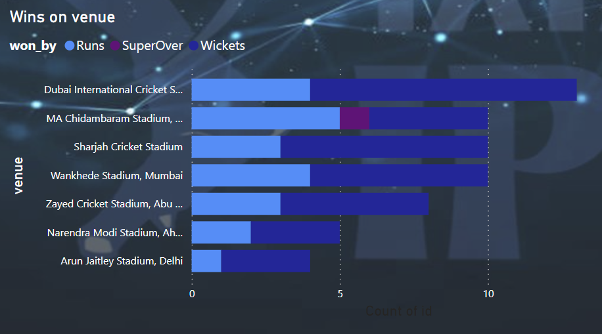
Wins on Venue:
Shows the distribution of wins at different venues (stadiums). For example, statistics include win counts at venues like M.A. Chidambaram Stadium, Wankhede Stadium, and more. This breakdown helps analyze team performance across various grounds, showing which teams performed well on specific pitches.

Slide 13
Wins by Team in a Season:
This bar chart visualizes the number of wins for each team within a particular season, with bars representing each team’s win count. In the example, Chennai Super Kings and Delhi Capitals have higher counts, indicating their strong performance.This chart allows viewers to compare team success in a single glance, highlighting which teams dominated the season.

Slide 14
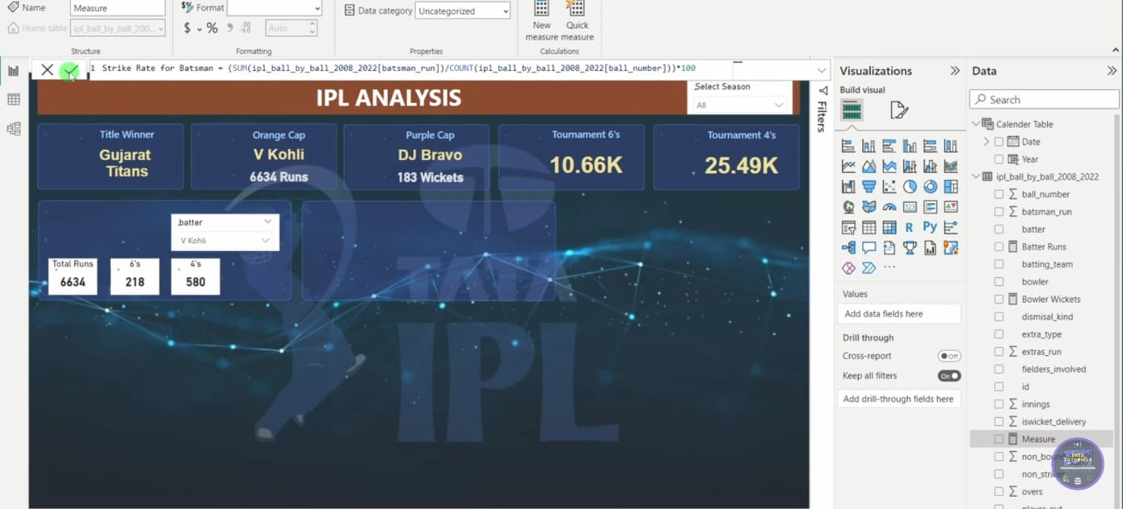
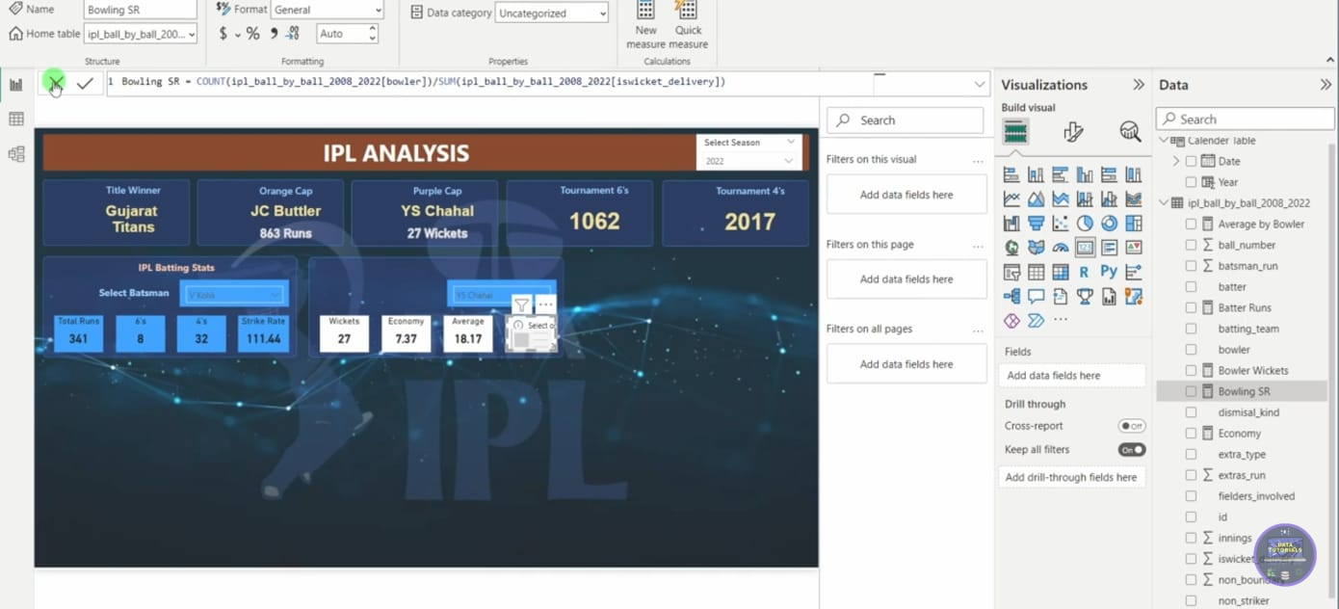
ADDITIONAL MEASURES :
STRIKE RATE :
BOWLING STRIKE RATE :

Slide 15
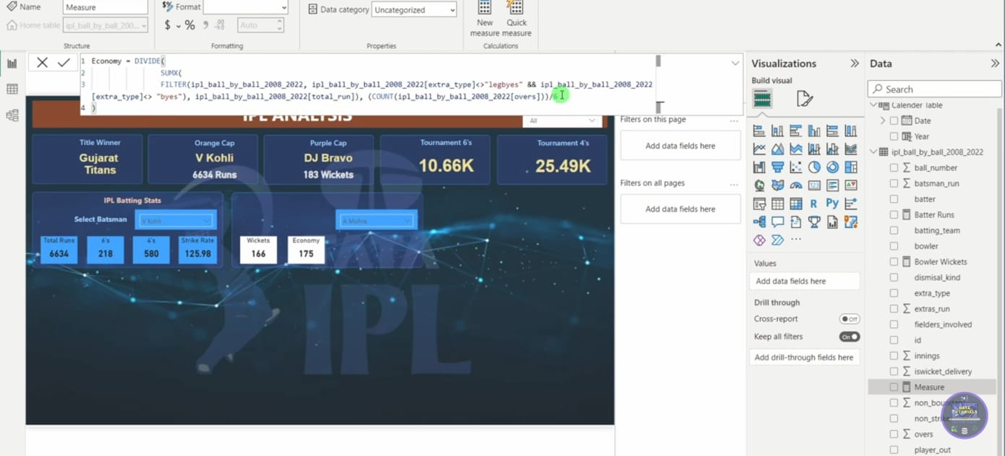
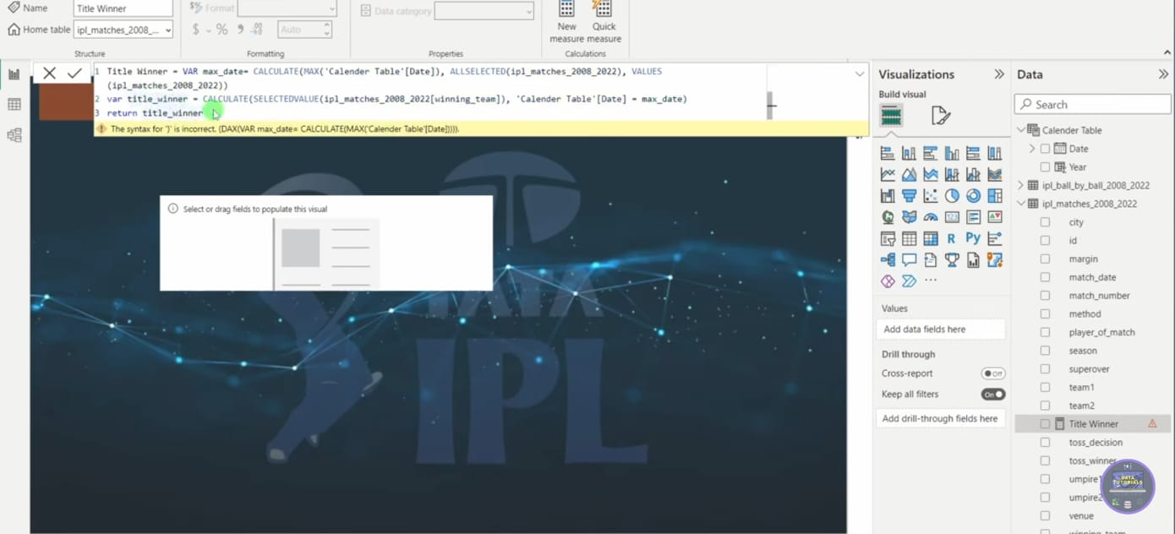
ADDITIONAL MEASURES :
ECONOMY :
TITLE WINNER :

Slide 16
ANALYSIS :
Batting Insights:
Run Scorers: MS Dhoni, highlighted in the batting stats, has accumulated an impressive total of 4,978 runs, indicating his crucial role in his team’s batting lineup. His high count of boundaries and sixes shows his ability to consistently score and accelerate when needed.
Strike Rate: With a strike rate of 130.93, Dhoni shows a good balance between scoring aggressively and maintaining consistency. This is a valuable trait for T20 cricket, where fast scoring is essential.
Power Hitters: The counts of fours and sixes provide insight into a player's ability to clear boundaries, which is key in T20 formats. High numbers of boundaries often correlate with match-winning innings, making boundary statistics an indicator of impact players.

Slide 17
ANALYSIS :
Bowling Insights:
Wicket-Taking Ability: DJ Bravo’s performance in the bowling stats section indicates his effectiveness as a wicket-taker, which is essential for disrupting opposition momentum.
Economy Rate and Average: Bravo’s economy rate (7.94) and average (21.06) suggest he is a reliable bowler who can control the flow of runs while taking crucial wickets. His strike rate of 15.92 highlights his knack for taking wickets at regular intervals, which can be key to shifting the balance in a match.
Bowler Consistency: These metrics are useful to identify bowlers who are not only economical but also have a high strike rate, making them valuable in T20 formats where containing runs is as crucial as taking wickets.

Slide 18
ANALYSIS :
Toss Decision Patterns:
The toss decision data highlights that teams have preferred strategies regarding batting or fielding first based on venue conditions, opposition, and team strengths. Teams opting to bat or field in different venues indicate how the pitch and environmental factors are being strategically considered.
Impact of Toss Decisions: The data on wins by runs, wickets, and Super Overs allows analysis of how crucial toss decisions can be. For instance, if teams winning the toss and choosing to bat have a higher winning percentage, it may indicate the advantage of setting a target on specific pitches.

Slide 19
ANALYSIS :
Venue-Based Performance:
Stadium Preferences: The "Wins on Venue" chart gives insights into team strengths across different stadiums. For instance, some teams may perform better in certain venues due to favorable pitch conditions, crowd support, or familiarity with the ground.
Home Advantage: Teams with more wins at specific stadiums may benefit from a home-ground advantage, where knowledge of pitch behavior plays a crucial role in game strategy.

Slide 20
ANALYSIS :
Team Performance Over a Season:
Top Performers: The bar chart showing "Wins by Team in a Season" indicates that Chennai Super Kings and Delhi Capitals have consistently performed well, with high win counts. This suggests these teams have well-rounded squads capable of winning matches across conditions.
Competitive Edge: The spread of wins across teams shows the level of competition in the season. Teams with fewer wins can analyze these stats to improve their strategies, player combinations, and decision-making in future games.

Slide 21
CONCLUSION:
This dashboard reveals key patterns and strategies that drive success in the IPL. From toss decisions to venue performance and individual player stats, the data enables an in-depth understanding of factors that influence match outcomes. Teams and players can leverage this data to identify strengths and weaknesses, optimize strategies, and enhance their performance in future tournaments.

Slide 22
THANK YOU

